Slide 1



Internship Presentation
At SmartCrowd
Jowher Mehajabin Juthi
August 10, 2023

Slide 2
Company
Profile
Location
Work Hour
Products & Services
SmartCrowd
InvestDubai
SmartCrowd KSA
Smartcrowd Pakistan

Slide 3
My Key
Contributions

Slide 4
Diverse Contributions
Feature Implementation
Bug Fixing & Optimization
Code Review

Slide 5
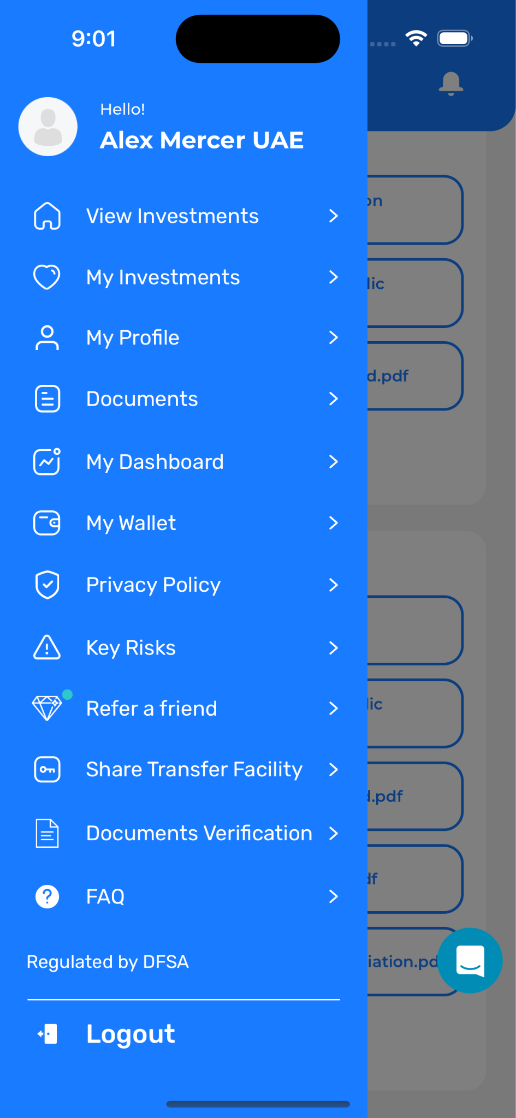
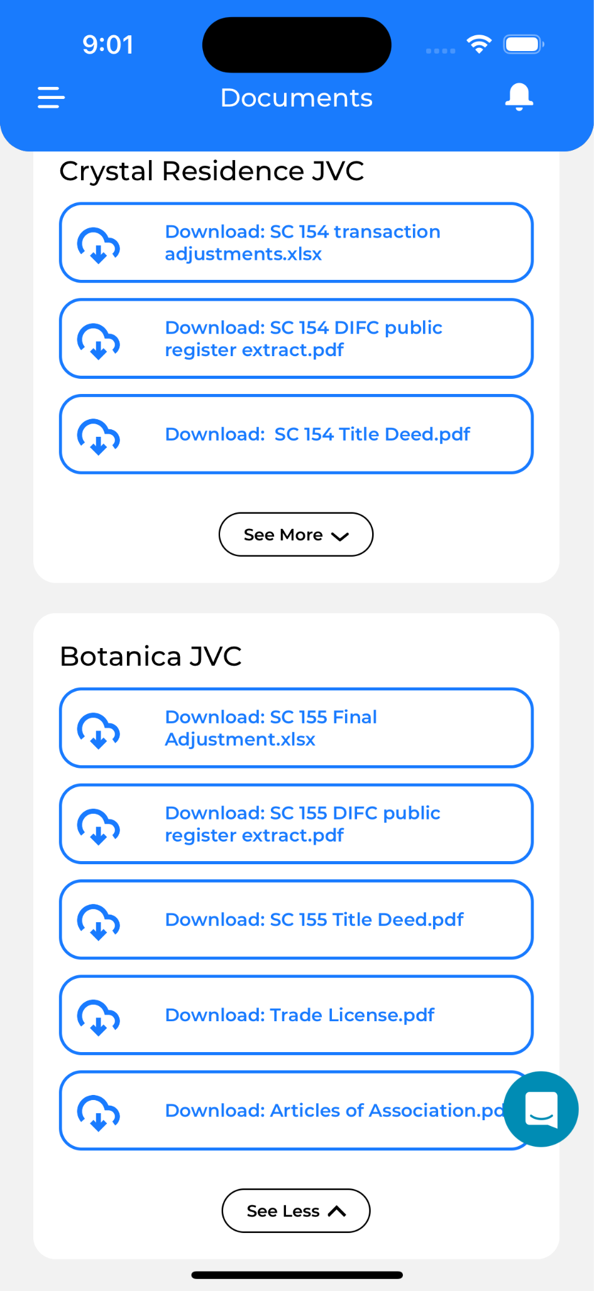
SmartCrowd

Slide 6
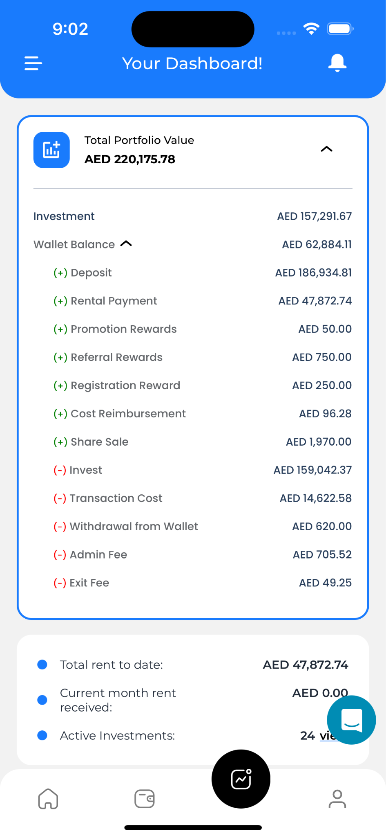
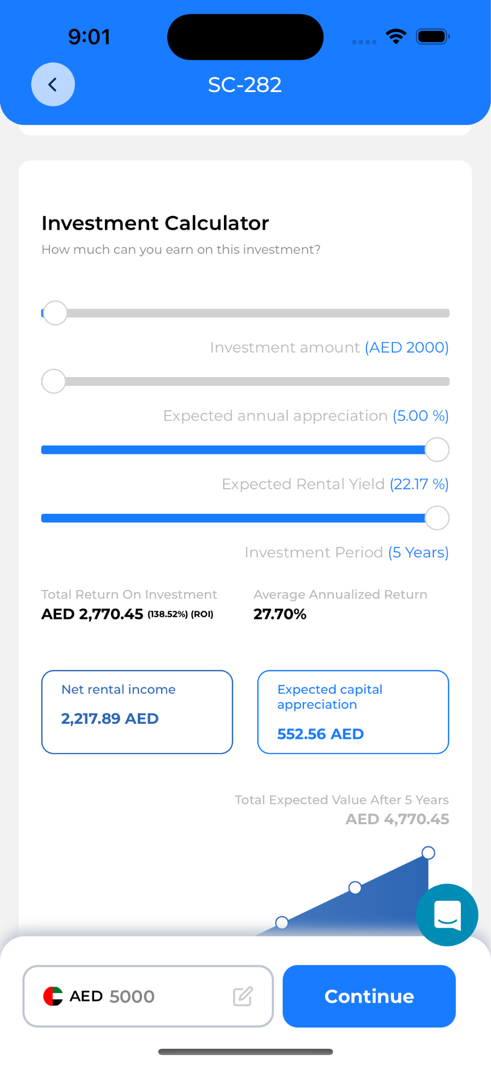
SmartCrowd

Slide 7
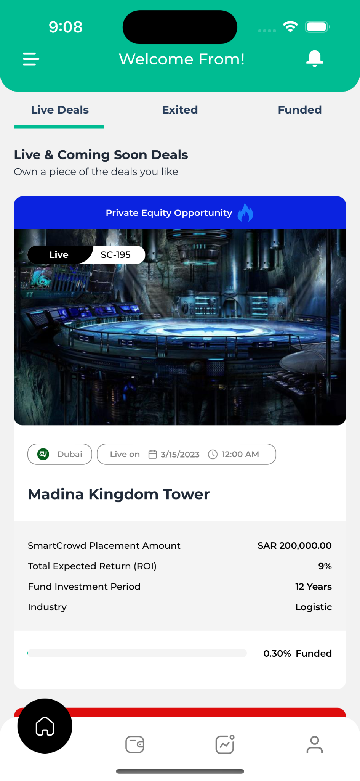
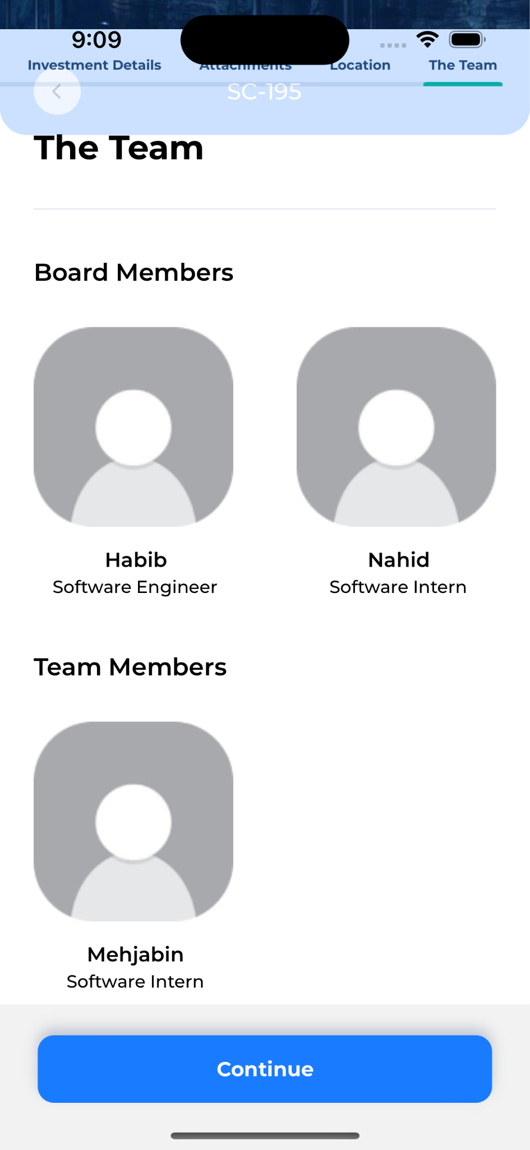
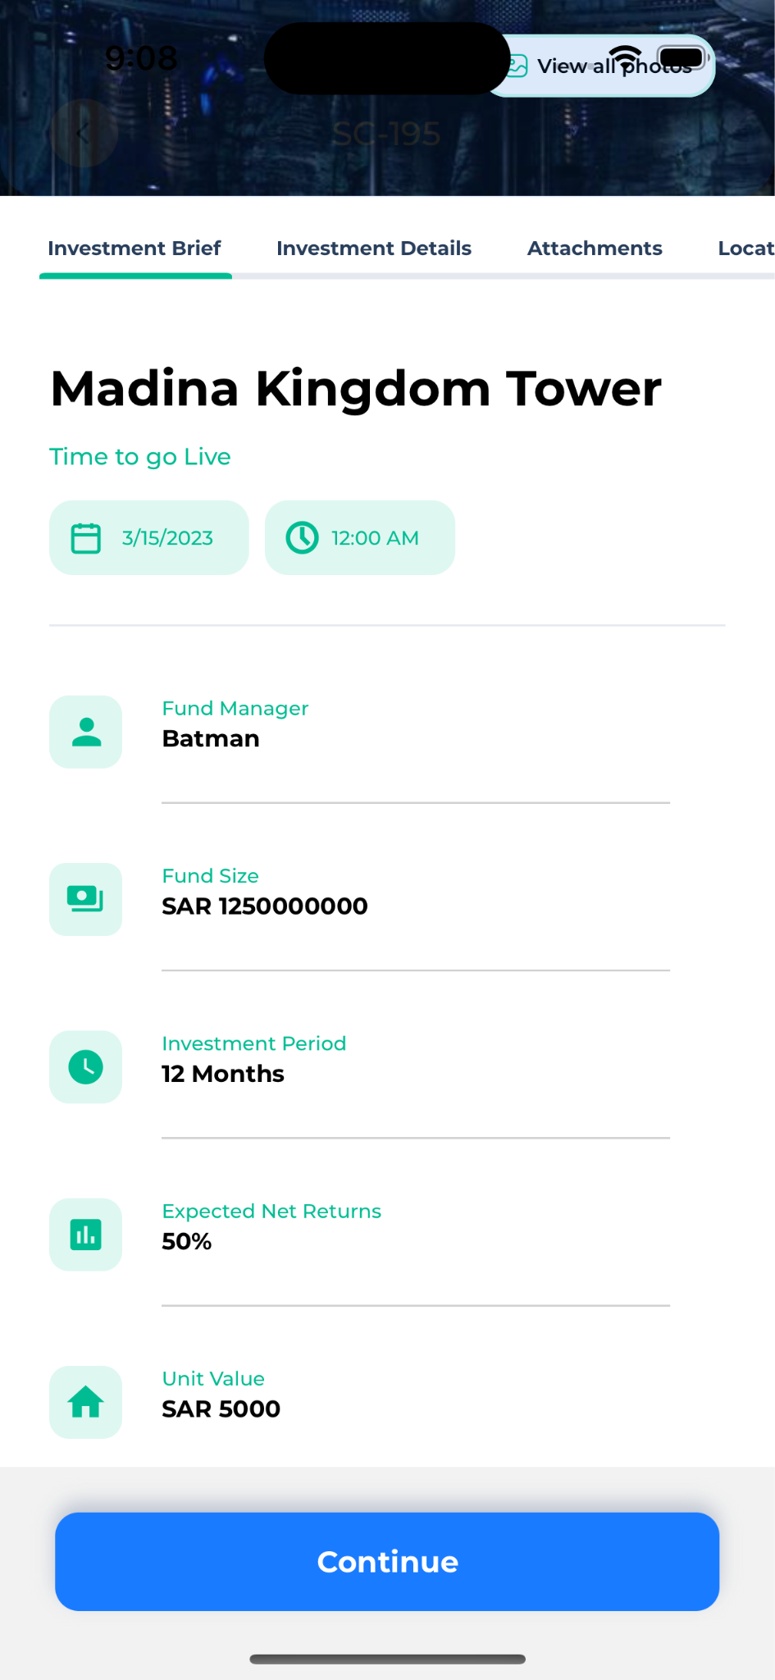
SmartCrowd KSA

Slide 8
Challenges
Understanding Codebase
Maintaining Code Quality
Optimizing Code Reusability
Navigating Unfamiliar Errors
Ensuring UI Consistency

Slide 9
Learnings & Growth

Slide 10
Technical
Learnings
Monorepo
Nx
Detox
Recoil

Slide 11
Technical
Learnings
Front End Technology
React Native
Typescript
React Hooks
Higher Order Component
Styled-component

Slide 12
Professional
Growth
Skill Development
Teamwork & Communication
Industry Exposure
Adaptability

Slide 13
Thank You
Any Questions?

